Slide 1
Project 3: The Reddit Classifier
r/Anger & r/Meditation - Vidhu
r/MentalHealth & r/Psychology - Clement

Slide 2

The Problem
Reddit was down and the tag of the subreddit somehow did not get saved
Data science team was tasked to reclassify the posts into their subreddits (/rAnger, r/Meditation and r/MentalHealth, r/Psychology)
Not all heros wear capes!

Slide 3
Approach Used
- Web scrape reddit to collect posts for 2 subreddit categories
- Make a dataset of combined posts
- Label categories as
- Category 1 - 1
- Category 2 - 0
- Save (on the disk as csv files) the big dataset for train/test purpose during modeling
- Read dataset to do cleaning
- do train/test split
- consider only words by using regex
- lower case the characters in posts
- apply lemmatization
- Use Count Vectorizer using stop-words to remove these words from features
- get the features list
- do this for train, test, final test dataset
- Train model
- For predictions
- check for train/test score
- accuracy of validation set
- Compare and recommend the best model based on comparison

Slide 4


Subreddits used
Anger
Meditation

Slide 5
Approach Used
- Web scrape reddit to collect posts for category - Anger, Meditation
- Make a dataset of combined posts
- Label categories as
- Anger - 1
- Meditation - 0
- From this dataset, randomly select 100 posts which will be used to test predictions on various model that will be used for modeling
- Save (on the disk as csv files) the big dataset for train/test purpose during modeling and sliced dataset as final test on model
- Read both dataset on do cleaning
- do train/test split
- consider only words by using regex
- lower case the characters in posts
- apply lemmatization
- Use Count Vectorizer using stop-words(including 'Anger' and 'Meditation' and synonym words to these categories) to remove these words from features
- get the features list
- do this for train, test, final test dataset
- Train model
- For predictions
- check for train/test score, final test score
- accuracy of validation set and final test set
- Compare and recommend the best model based on comparison

Slide 6
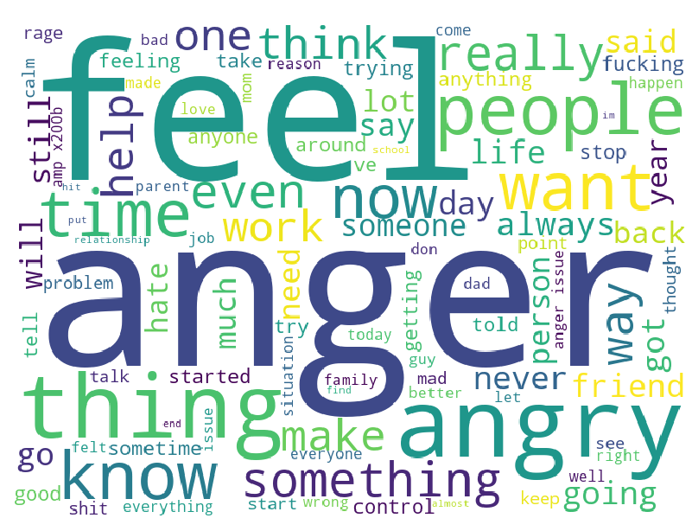
Word Cloud of category – Anger
Word cloud before removing category related words from posts

Slide 7
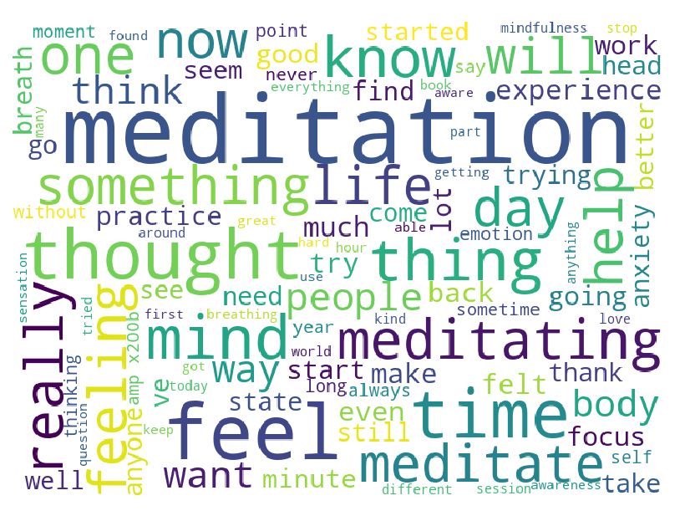
Word Cloud of category – Meditation
Word cloud before removing category related words from posts

Slide 8
Common high frequency words between two categories

Slide 9
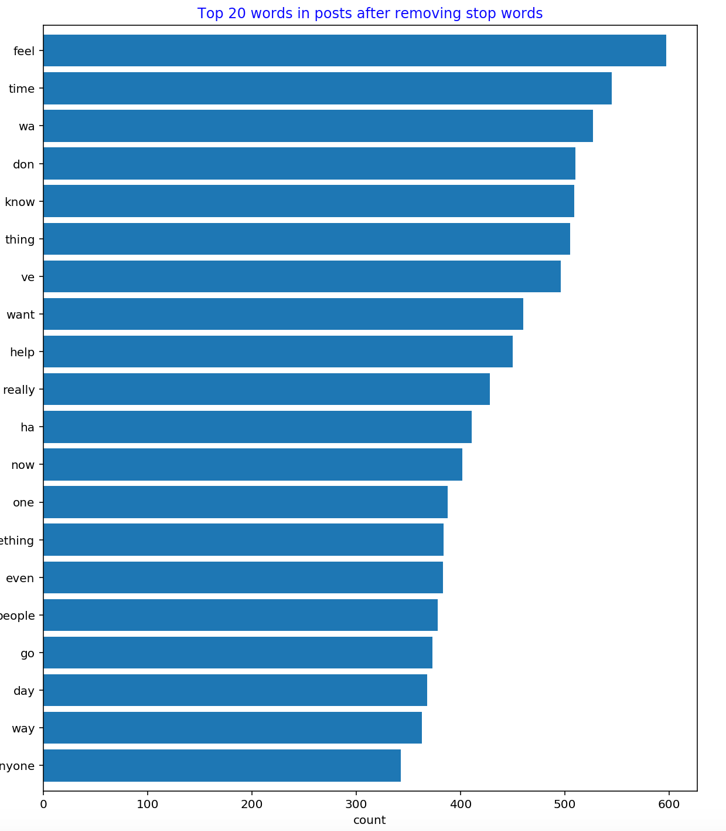
Top 20 words from the bag of words after removing stop words – including category related words

Slide 10
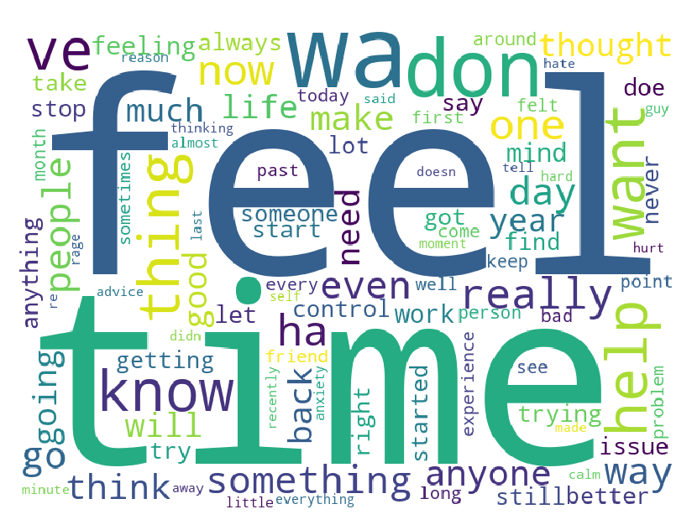
Word Cloud of common words after cleaning posts

Slide 11
Modeling
Logistic Regression model using Lasso
Logistic Regression model using Ridge
Multinomial Naïve Bayes model
Random Forest

Slide 12
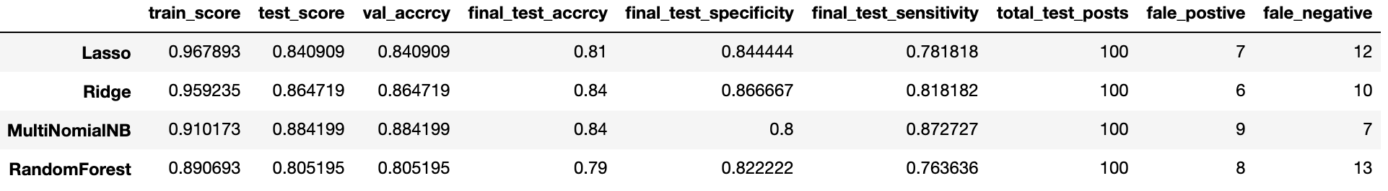
Comparison Matrix

Slide 13
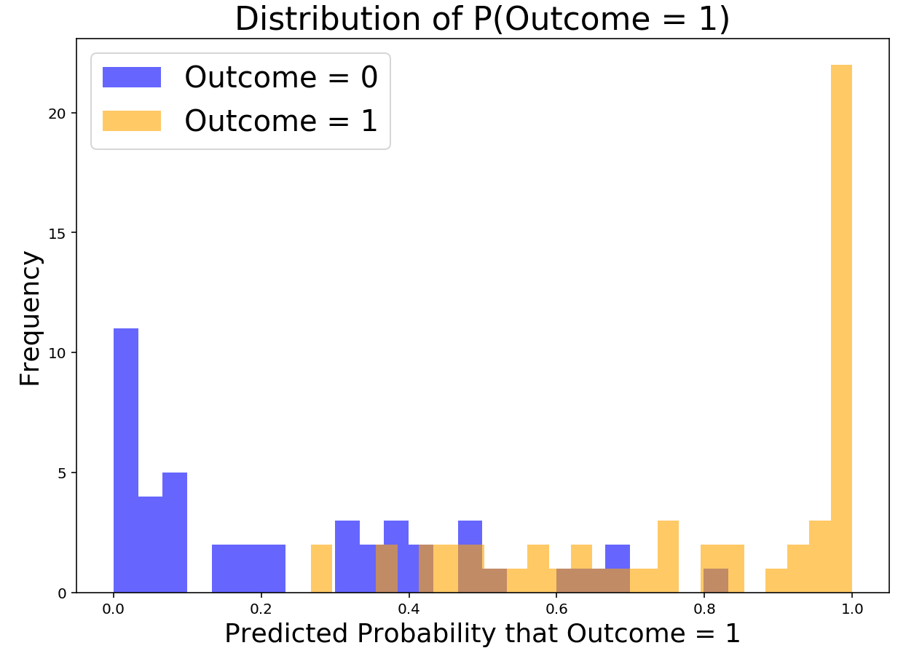
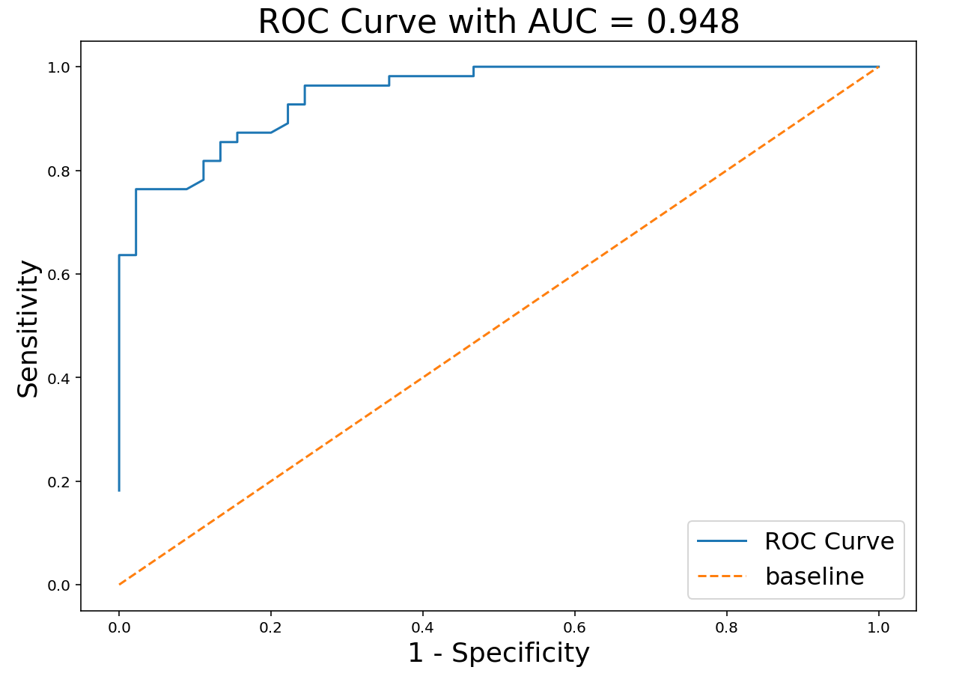
Naive Bayes (Multinomial) Classification Model
Predicted Probability and ROC Curve with AUC on final Test Set

Slide 14
Conclusion and Recommendation
- Have fit 4 models on reddit posts with two categories - Anger and Meditation labeled as 1 and 0
- Lasso Logistic Regression model
- Ridge Logistic Regression model
- Multinomial Naive Bayes model
- Random Forest model
- From above metrics it can be seen that Multinomial NB and Ridge Logistic Regression have good validation and accuracy score with final Test accuracy of 0.84
- Need more posts to train the model so that model can give good test accuracy and can be used for best predictions
- From above metrics Multinomial NB can be considered as best fit

Slide 15
Project 3: Reddit Classifier
r/MentalHealth & r/Psychology

Slide 16
Subreddits used
r/Psychology
r/MentalHealth

Slide 17
EDA

Slide 18
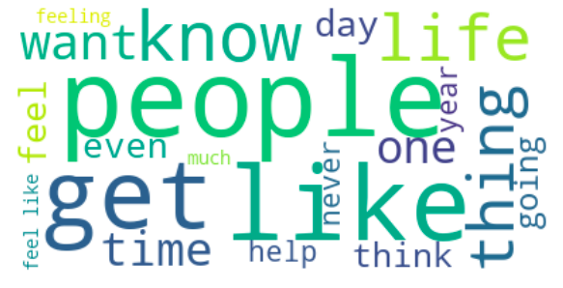
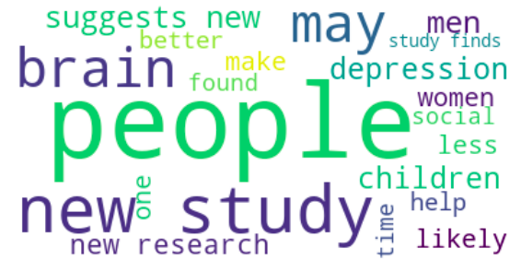
r/MentalHealth
r/Psychology

Slide 19
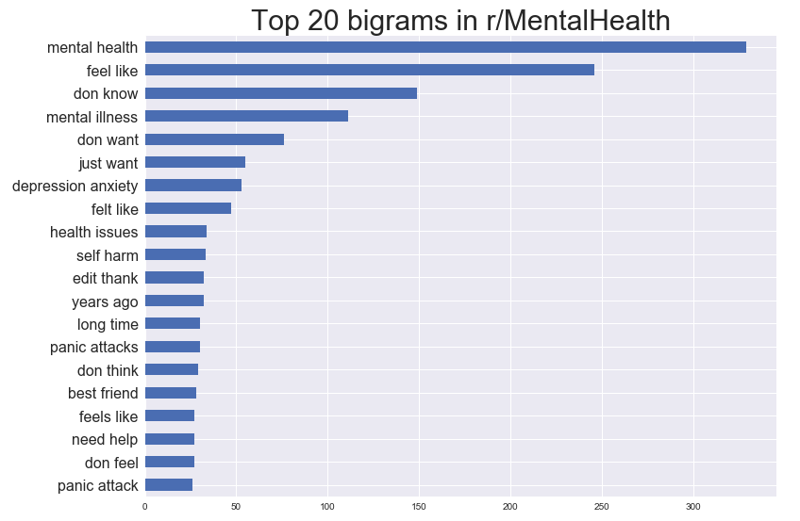

Slide 20
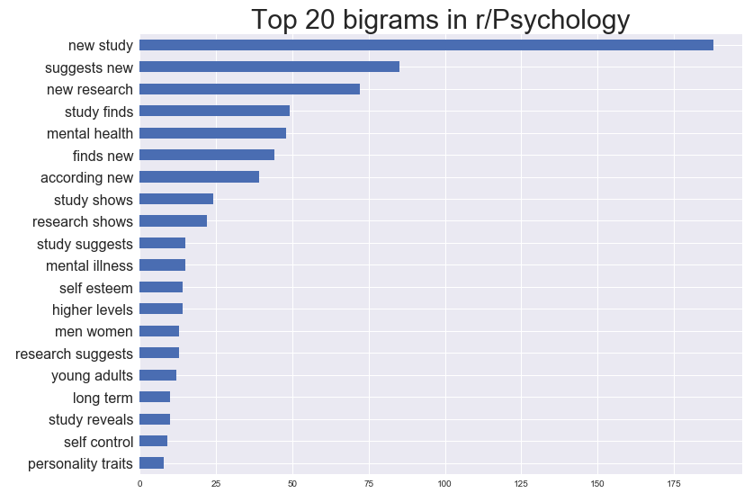

Slide 21
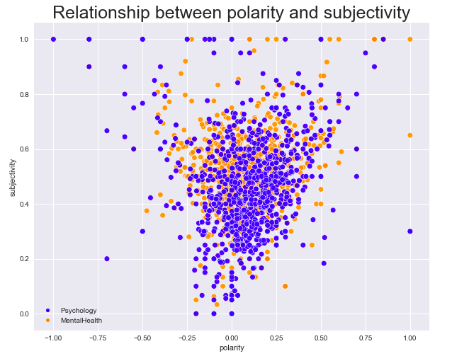

Slide 22
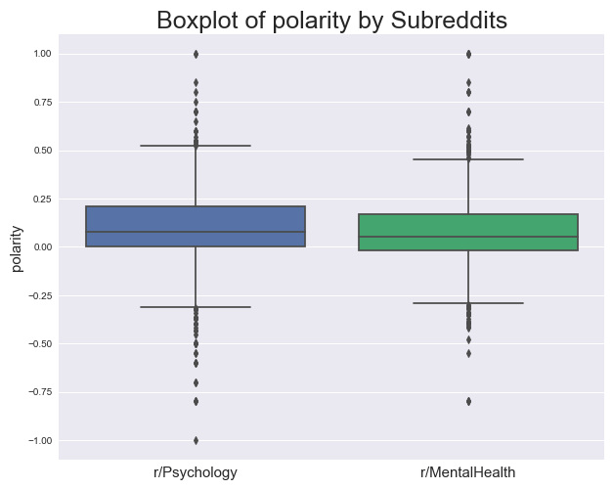

Slide 23
Modelling

Slide 24
Summary of modelling
Model | Training Score | Test Score | ROC AUC Score
Logistic Regression | 0.999 | 0.948 | 0.98
Naive-Bayes | 0.962 | 0.946 | 0.985
Random Forest | 1 | 0.944 | 0.99

Slide 25
r/Psychology | r/MentalHealth
benevol | zoloft
increas risk | know wa
wa link | know think
gap | know thi
bia | know struggl
favour | know peopl
studi reveal | know need
moral | know love
differ men | know like
perform better | know life
enhanc | know happen

Slide 26
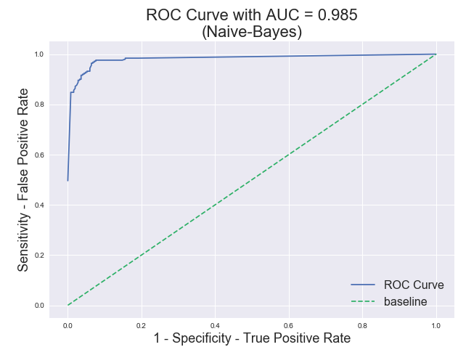

Slide 27
Misclassification
26-27 False Positive and False Negative

Slide 28
Misclassified as r/Psychology
"U.S. Suicide Rates Are the Highest They've Been Since World War II [U.S. suicide rates] are at their highest since World War II, according to federal data and the opioid crisis, widespread social media use and high rates of stress may be among the myriad contributing factors."
Usually posted in r/Psychology, very objective kind of headline

Slide 29
Misclassified as r/MentalHealth
"In light of the very tragic Connecticut Elementary School shootings, everyone is now bringing up gun control again. What no one is talking about (and never seems to talk about) is helping to increase mental health healthcare in the country. And it's pissing me off."
Usually posted in r/MentalHealth, very subjective posts

Slide 30
Conclusions and Limitations
Naive-Bayes Multinomial is the best classifier
Good balance of bias and variance tradeoff
Bag-of-words approach used
Each word is considered independent
Does not have context

Slide 31
Recommendations
Increase number of posts from other subreddits
Identify and input more features into the model
Looking at linguistic features (emojis, POS tagging, Entity recognition etc.)
Using sentiment analysis
Length of posts

